Slide 1
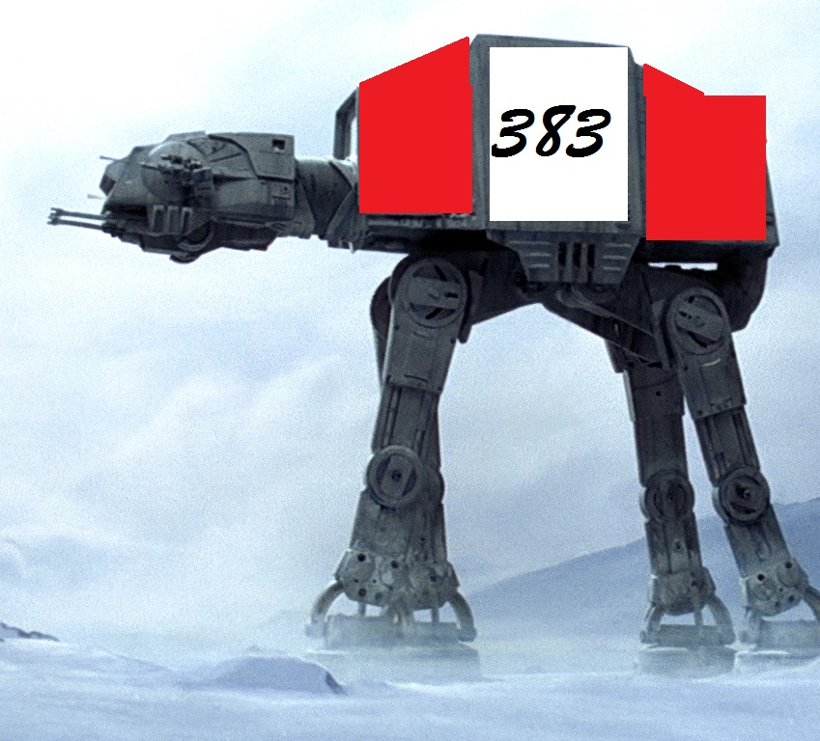
Sound Sentinel by 383 Studios

Slide 2
383 Studios
Amanda
Lead coder and environment creator
Tristan
Game object interactions and creation, and “fun” guy
Austin
Documentation, menus, and time tracking
Tyrel
Music, video, text to speech , testing

Slide 3
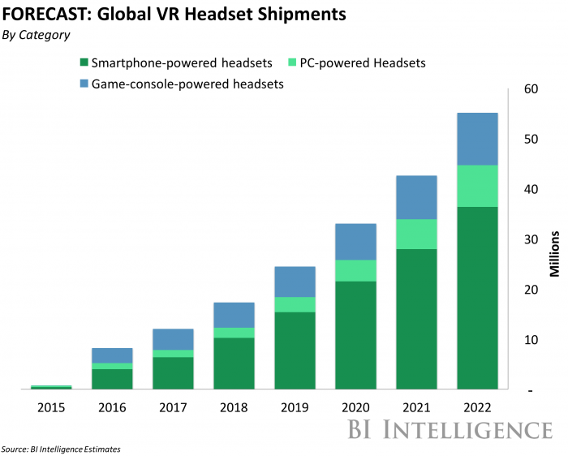
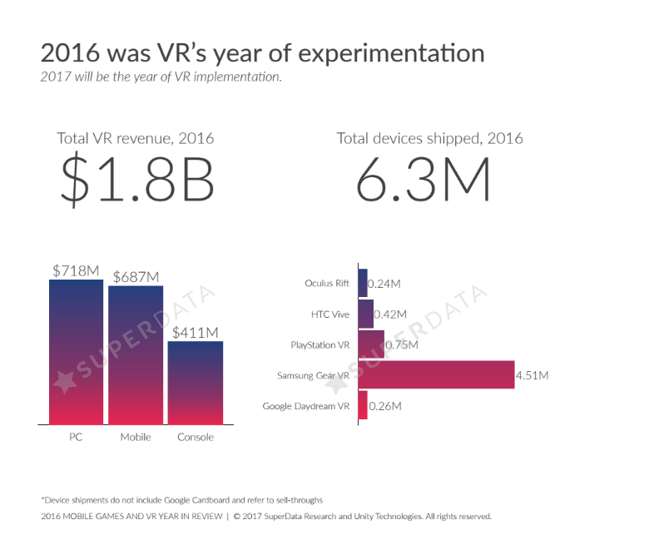
The VR market
The VR market is expanding exponentially

Slide 4
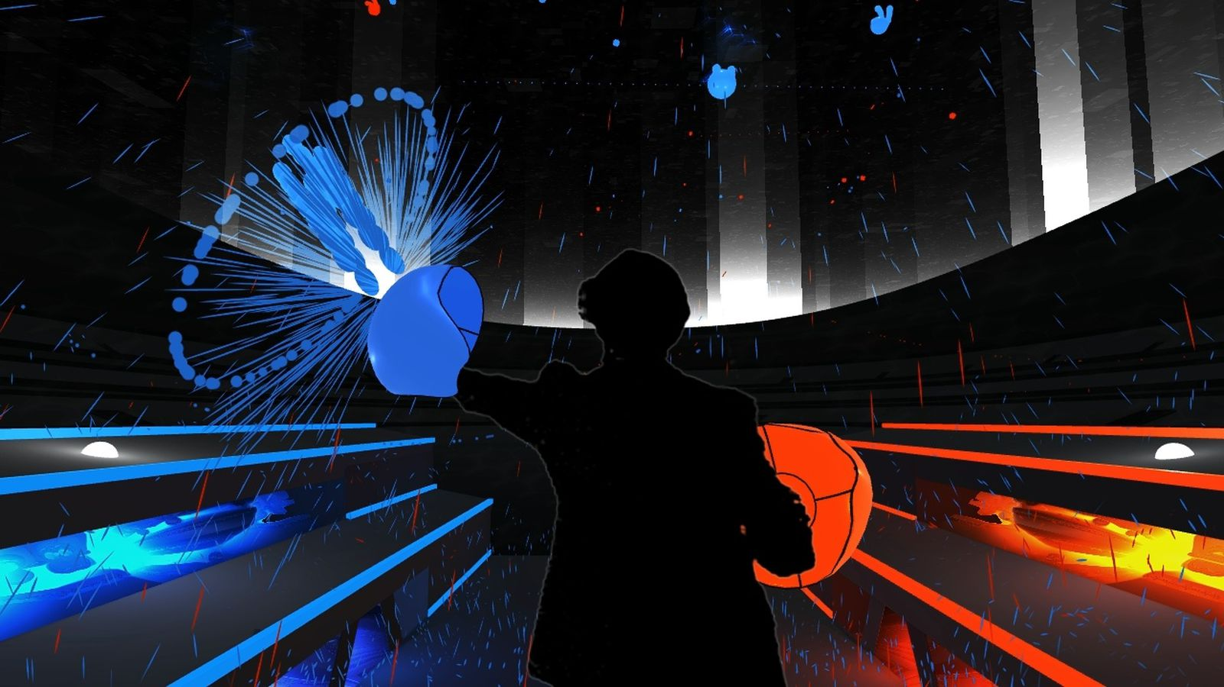
Audioshield
Inspiration
One of the best selling games of 2018, despite coming out in 2016
STEAM reviews: 2269 positive to 34 negative
Easy to learn, hard to master
But its limited….

Slide 5
Sound Sentinel
Walkthrough & Overview
It’s part pool, ping pong, and dodgeball
Gameplay will include:
Ball physics where balls can be deflected back at each other
Increasing ball speed and angle of attack
Targets for the player to hit balls to that will give power up rewards
Balls that change color when deflected
High score tracking
Audioshield lost its YouTube video components, we plan to have that, and expand on it
Other Features
In game video, audio, and desktop support
Text-to-speach functionality
Offsite high capacity database storage for saved games

Slide 6
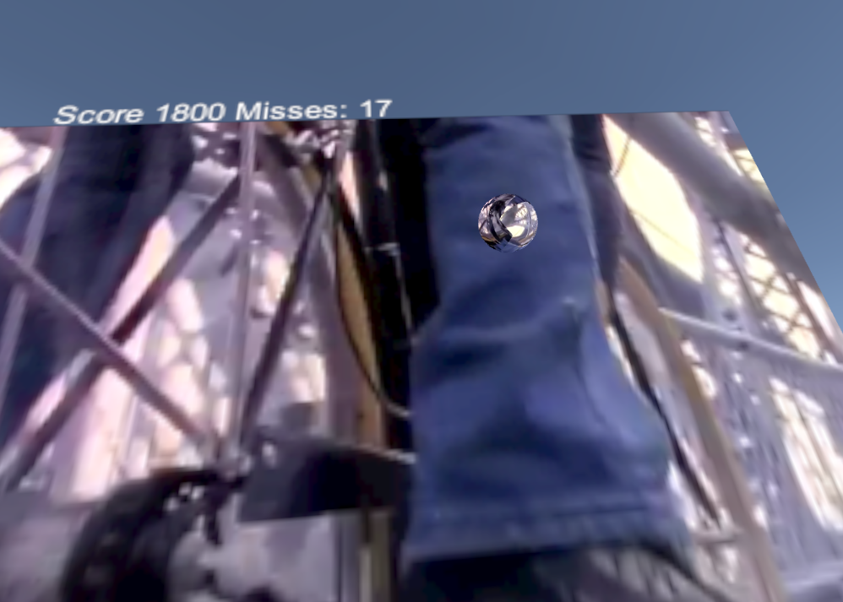
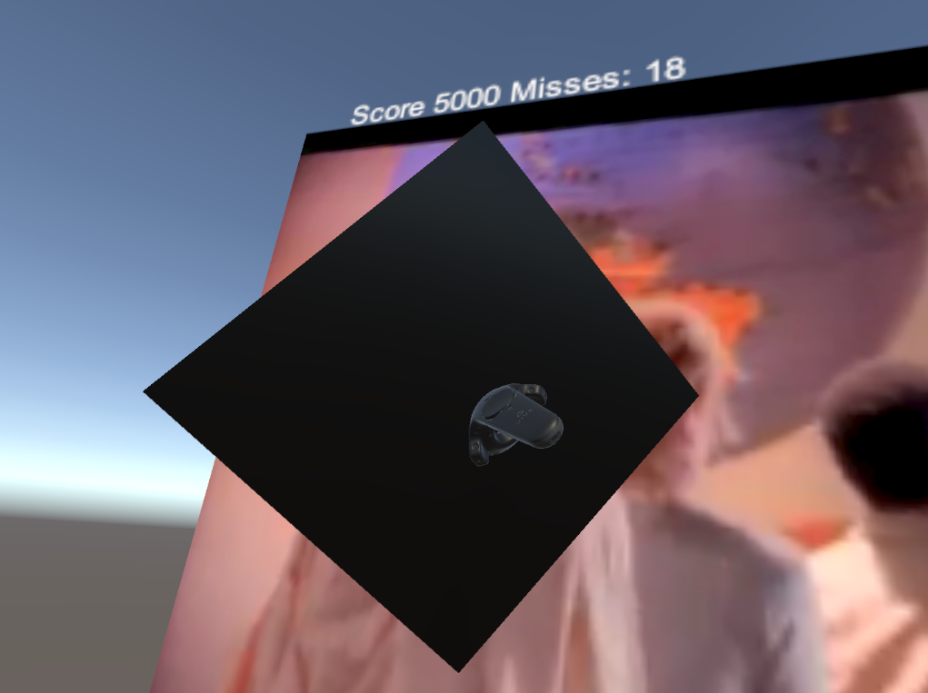
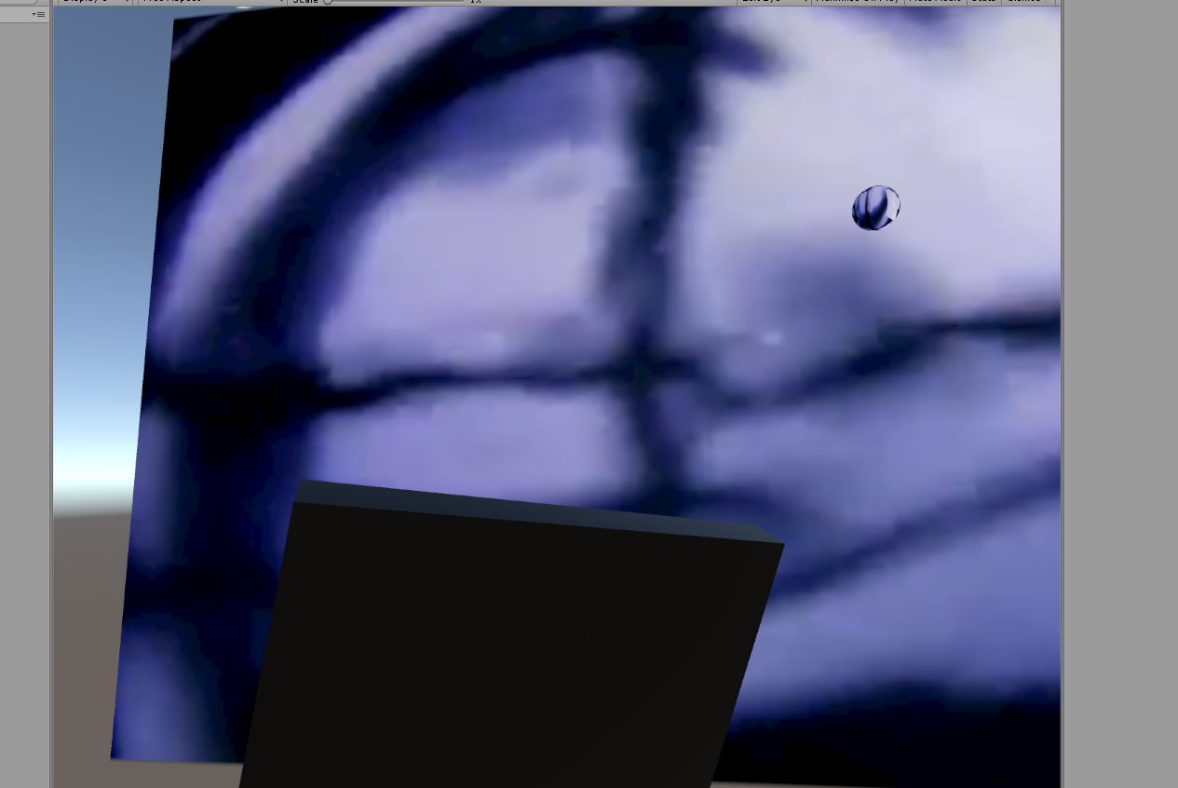
Proof of Concept

Slide 7
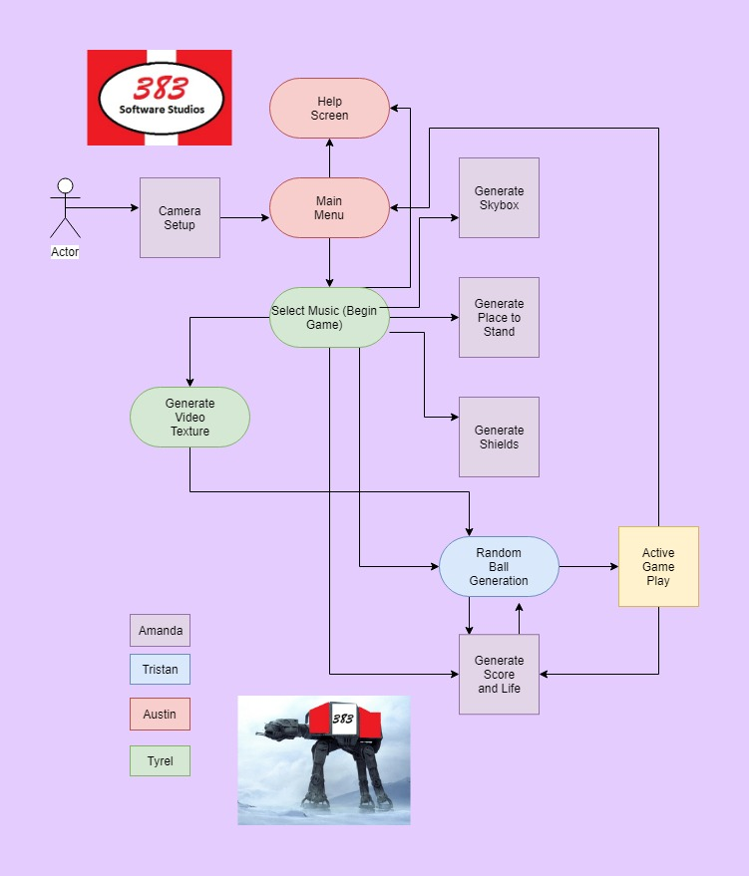
Overview

Slide 8
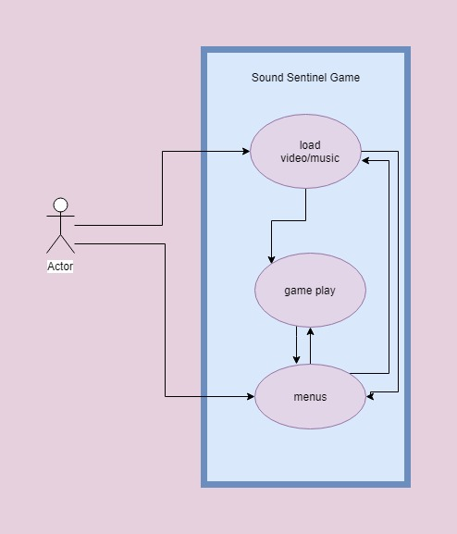
Global Use Case

Slide 9
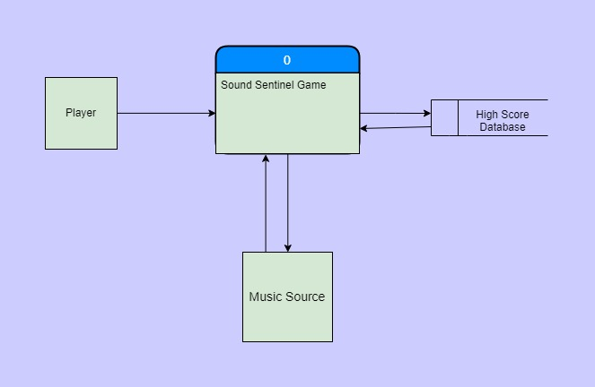
Context Diagram

Slide 10
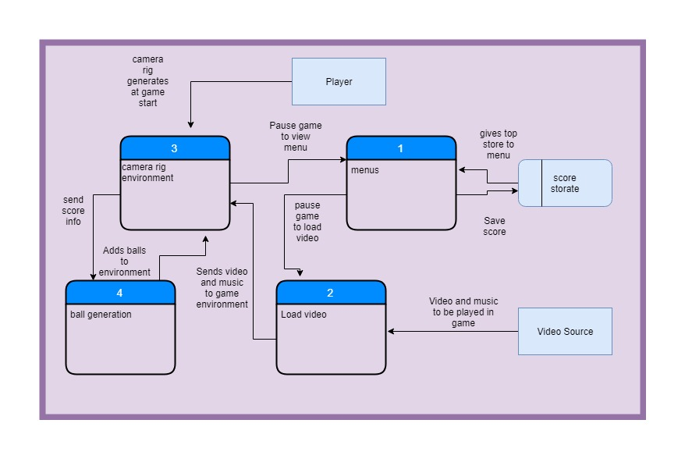
Diagram 0

Slide 11
Amanda
Feature – Environment
I will be providing the space for the gameplay to take place
Priority
Different portions of the environment have higher priorities than others. For example, nothing will happen without the camera rig, but game play can continue without score keeping
Complexity
There is a wide range of complexity
The initial “bare bones” design does not need to be complex.
The sky is the limit for complexity the more and more we add to the game

Slide 12
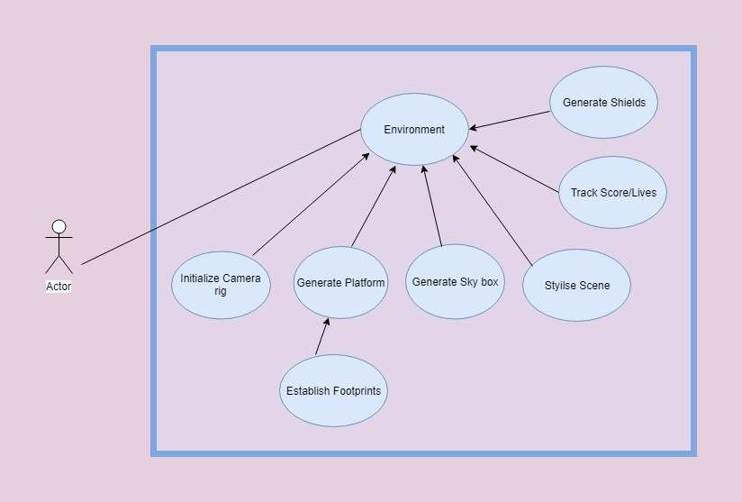
Amanda

Slide 13
Tyrel
Feature – Music/Video
I will be implementing the Mu
Priority
Implement music, video and text-to-speech
Complexity
Streaming music/video could cause lag in the game
Text-to-speech might have a lot of overhead

Slide 14
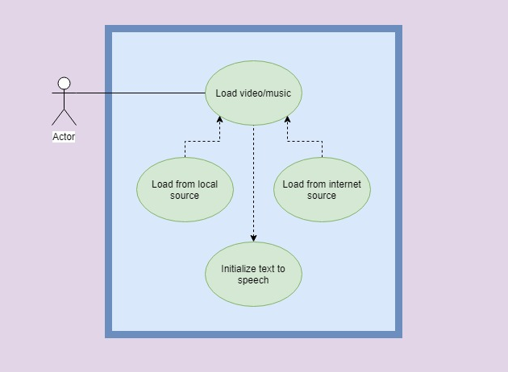
Tyrel

Slide 15
Austin
Menus
Provide all user interaction outside of regular gameplay.
Priority of menu changes based on its purpose
main menu is high priority can’t start the game without it
pause menu is nice to have
Menus themselves aren’t very complicated but some functionality like high scores add complexity.

Slide 16
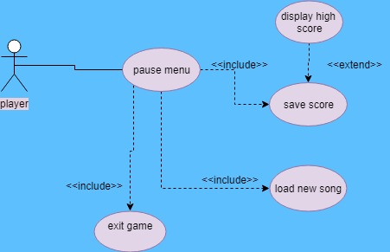
Austin
use case diagram

Slide 17
Tristan
Ball generation and core gameplay loop
Without ball generation, you just have a boredom simulator
This will include different kinds of projectiles, targets, scores, and rewards
This should be easy to initialize, and I plan on using some of my existing code as a template but take will a while to polish to a point where gameplay is enjoyable
Most of these features can be coded independently of the rest of the project, but will require a functional game to test

Slide 18
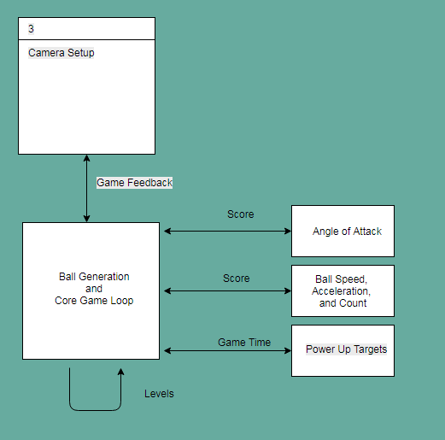
Tristan
Usecase diagram

Slide 19
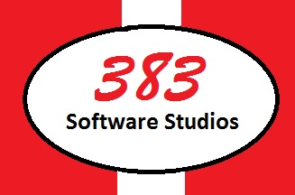
Questions?

Slide 20

Sound Sentinel
Demo video:
Also, shampoo

Slide 21
